Slide 1
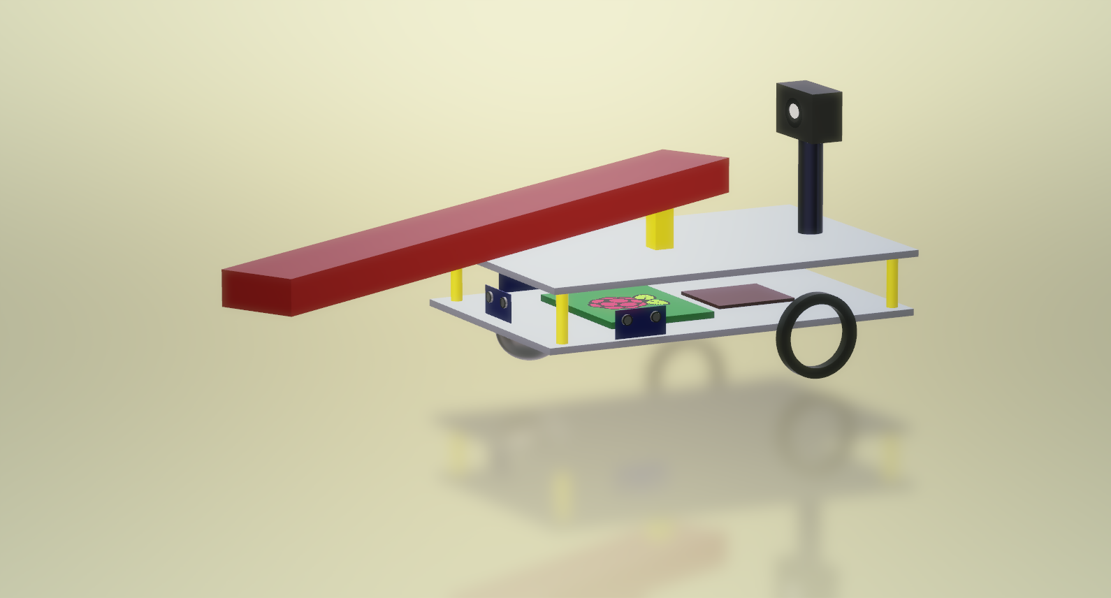
X-Cali Group
Burak Sezgin - 2094456
Taha Doğan - 2093672
Göksenin Hande Bayazıt - 2093441
Emre Doğan - 2093656
Oytun Akpulat - 2093201

Slide 3
«Robots collaboratively carrying a long object through an open-top maze»

Slide 4
Outline
Problem Statement
Subsystems & Solution Approach
Solutions
Main Solution
Alternative Solution
Management
Test Plans

Slide 5
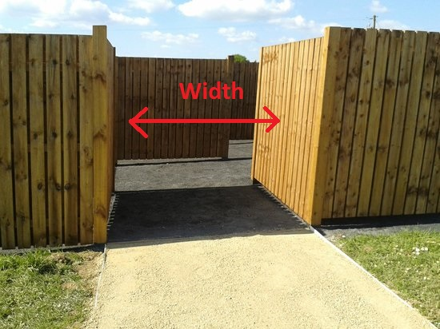
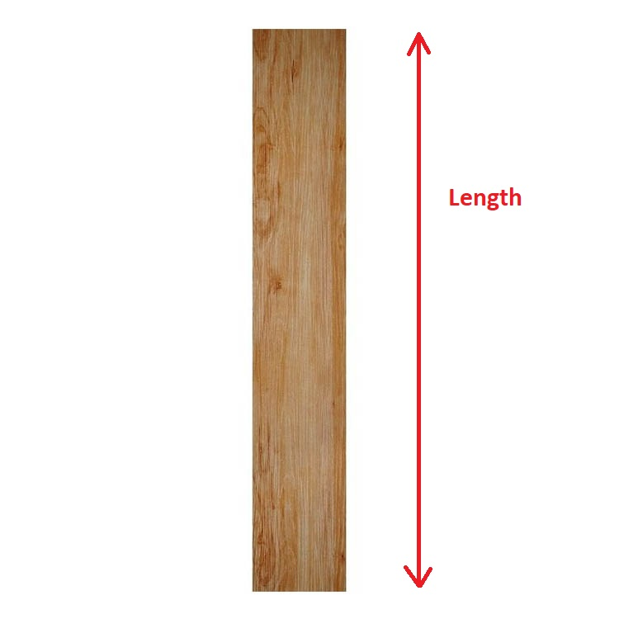
Related Specifications

Slide 6

Problem Statement
Cannot make U-Turn at once

Slide 7
Main Problem
Determining
And observing the other robot

Slide 8
Modes of Operation
Master
Slave

Slide 9
U-Turn Example
(I)

Slide 10
U-Turn Example
(II)

Slide 11
U-Turn Example
(III)

Slide 12
U-Turn Example
(IV)

Slide 13
U-Turn Example
(V)

Slide 15
Subsystems & Solution Approach
Subsystems
Movement
DC Motors
Wheels
Sensors
Active sensors
Passive Sensor: Camera
Decision and Control
Solution Approaches
Image Processing
Advancing Hall Effect

Slide 16
Subsystems – Movement
Motor and Wheel
DC motor
Normal wheel
Mad Wheel

Slide 17
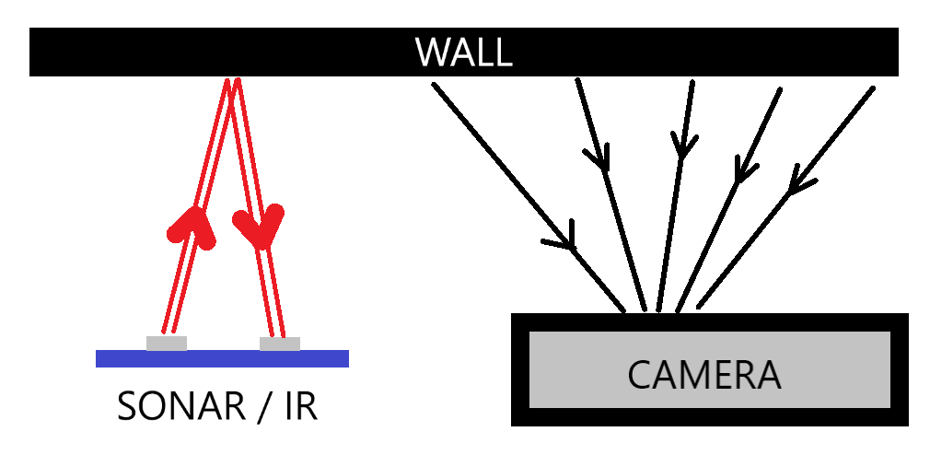
Subsystems – Sensors
Active Sensors: Proximity
IR sensors
Sonar Sensors
Passive Sensor: Camera

Slide 18

Subsystems – Decision and Control
Microprocessor Select: RaspberryPi3
Fast computational skills
Wi-Fi Connection
Versatility on different applications: Image Processing
DC Motor Driver: L298P
Back EMF protection
Easy-to-use ports
Frequently used, many instructive videos

Slide 19
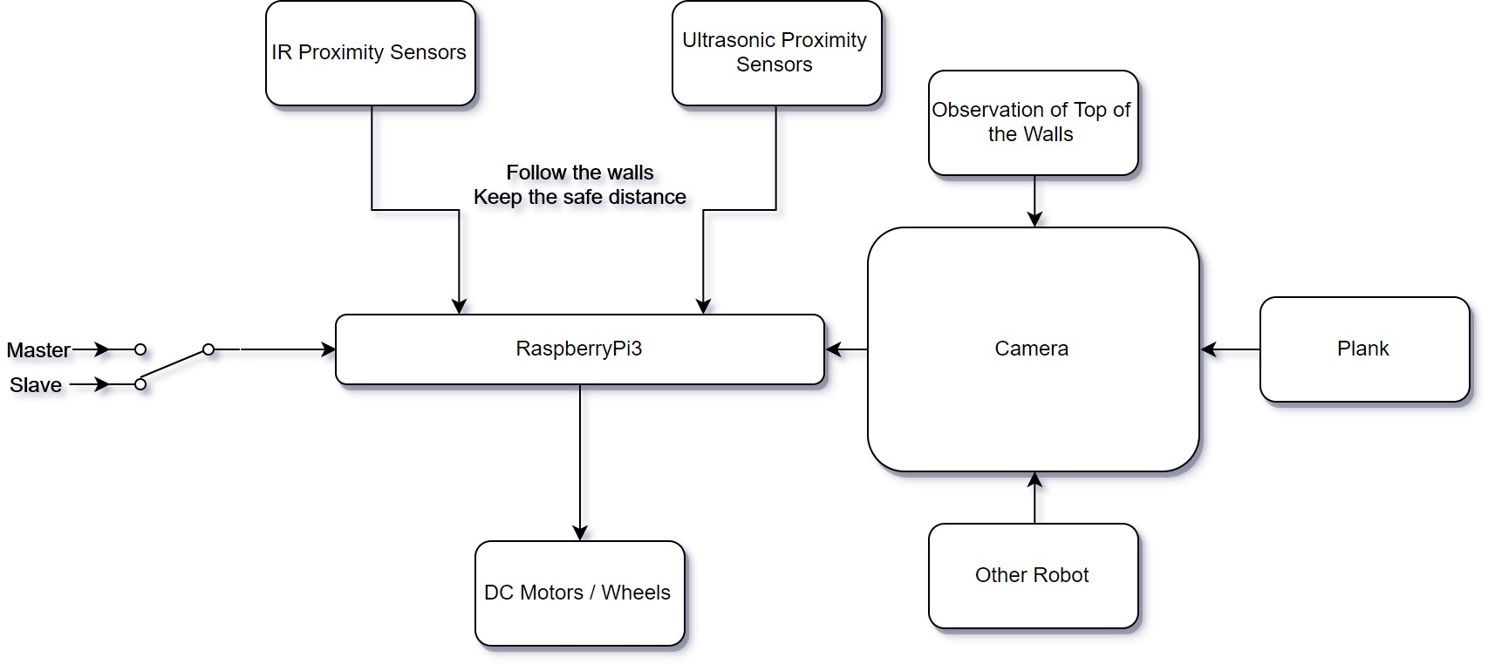
Solution Approach – I: Image Processing

Slide 20
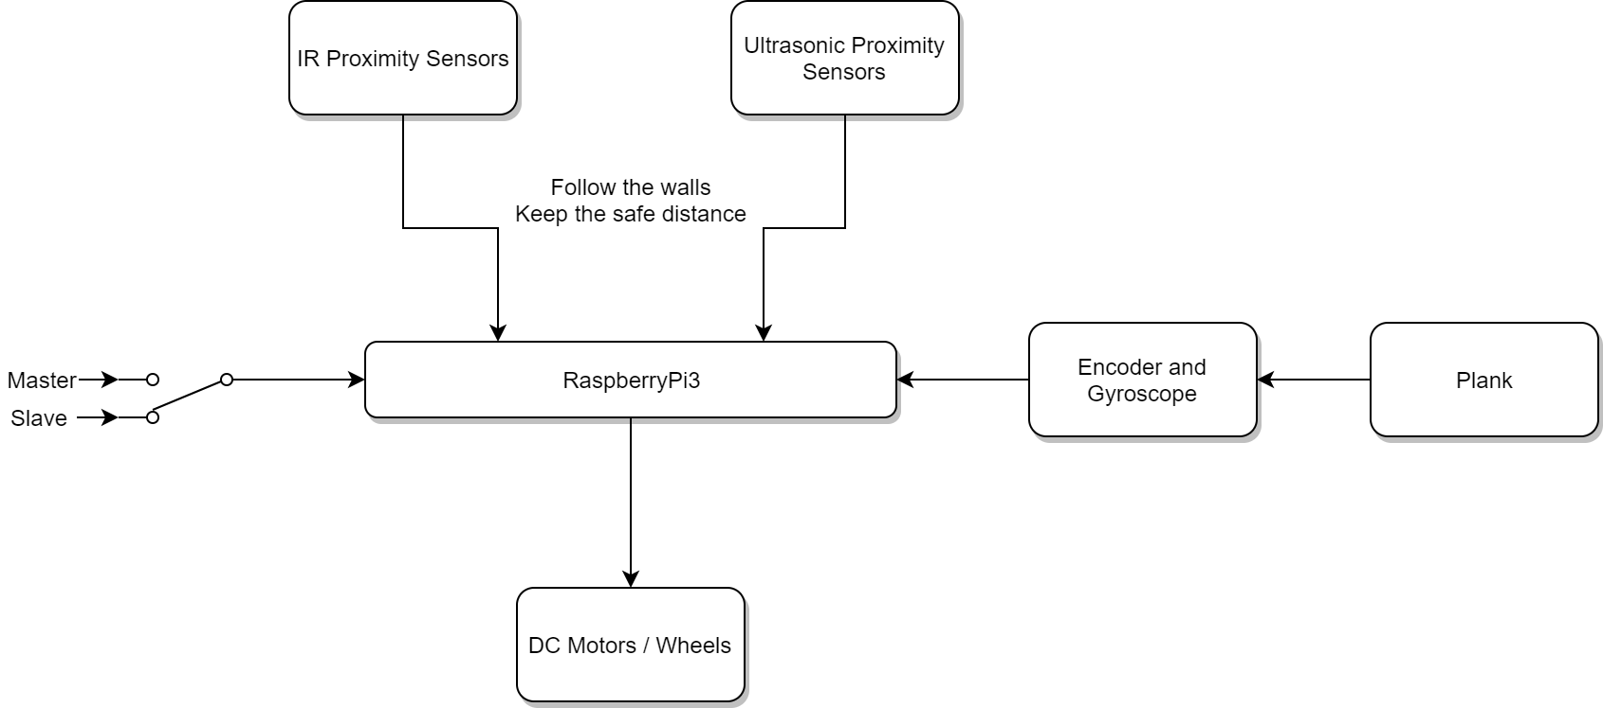
Solution Approach – II: Advancing Hall Effect

Slide 21
Solution Approaches (Technical Details)
Indirect communication between the robots
Angle of holding point
Image processing based
Motion-sensing based

Slide 22
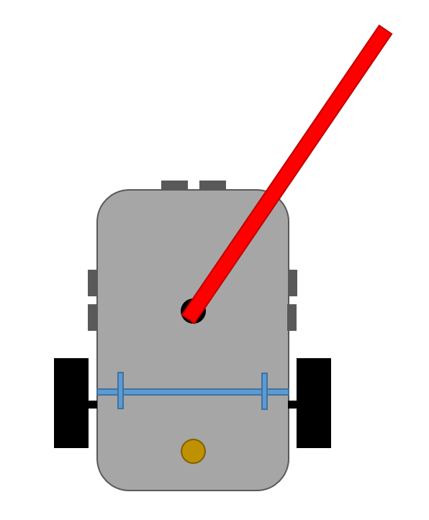

Solution I: Image Processing

Slide 23
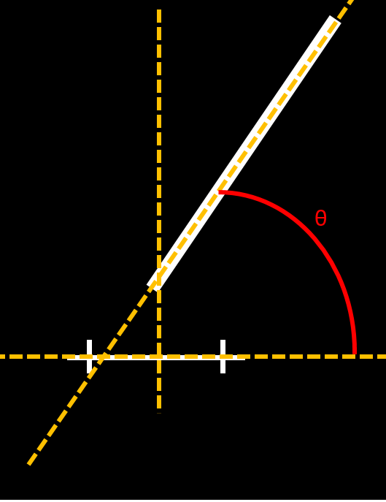
Solution I: Image Processing

Slide 24
Solution I: Image Processing
Feasible
Environment dependent
Reliability problems

Slide 25
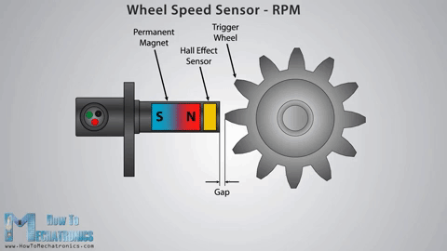
Solution II: Motion-Sensing

Slide 26
X-CALI
Control Systems
Mechanical Design
Microprocessor Programming
Communication Systems
Algorithm Design
Hande Bayazıt
Oytun Akpulat
Taha Doğan
Burak Sezgin
Emre Doğan
Taha Doğan
Burak Sezgin
Oytun Akpulat

Slide 27
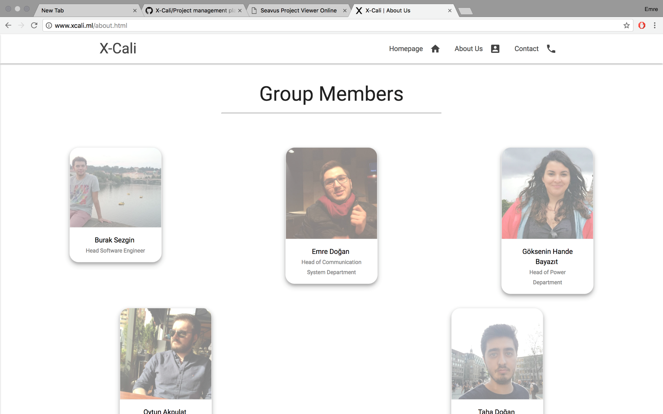
http://www.xcali.ml/

Slide 28
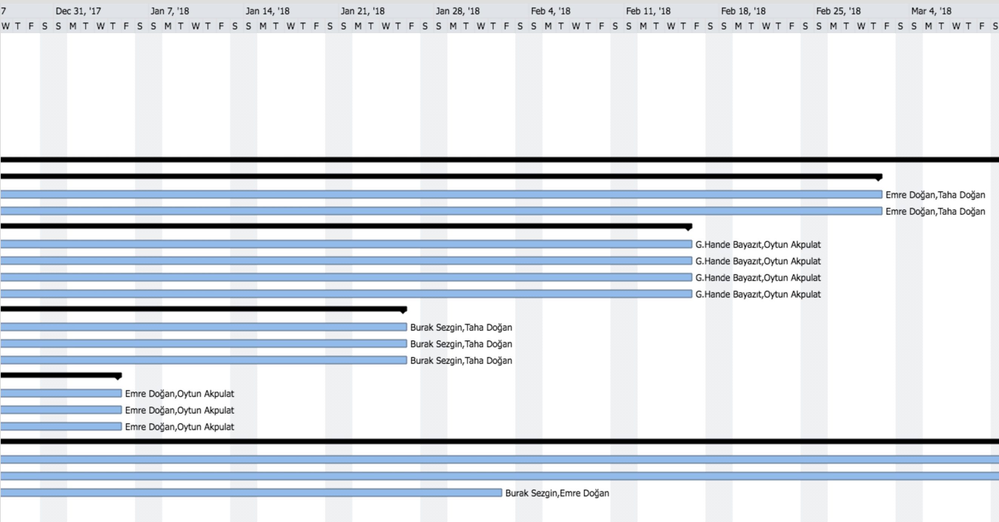
Package Management

Slide 29
Cost Analysis and Funding
Product Name | Price Per Product | Quantity | Total Price
Raspberry Pi 3 | 181.65 ₺ | 1 | 181.65₺
HC-SR04 Arduino Ultrasonic Distance Sensor | 5.50₺ | 4 | 22.00₺
E18 D80NK Infrared Sensor | 22.75₺ | 4 | 91.00₺
Logitech C270 Webcam | 115.75₺ | 1 | 115.75₺
L298N Motor Driver | 12.00₺ | 1 | 12.00₺
Ball transfer unit | 4.20₺ | 1 | 4.20₺
Robot Chassis & Wheels | 50.00₺ | 1 | 50.00₺
Jumper Cables | 10.00₺/set | 1 | 10.00₺
11.1V 1300mA LIPO Battery | 69.50₺ | 1 | 69.50₺
LIPO Battery Charger | 45.00₺ | 1 | 45.00₺
24V-5V 3A DC to DC USB Power Module | 6.65₺ | 1 | 6.65₺
 |  | TOTAL PRICE | 607.75₺ ($161.15)

Slide 31
Project Deliverables
The Work Package | Corresponding Deliverable
Research | Tentative Report
Component Tests | Results and analysis of the component tests
Communications Subsystem Design | Results of the procedure of receiving& processing data
Mechanical Subsystem Design | Driving tests and analysis of the robot’s performance
Software Subsystem Design | Documentation of the algorithms and debugging results
Overall System Implementation& Tests | A robot completing the labyrinth by itself
Demonstration | A robot completing the labyrinth collaboratively with the other groups. The product within its package.

Slide 32
Product Deliverables
PDF Version of the Manual
www.xcali.ml/about.html

Slide 34
Customer Care
2 year warranty supplied.
Maintenance & Repair.
http://xcali.ml/contact.html

Slide 35
Foreseeable Difficulties

Slide 36
Test Plans
Integration Plans
Conclusion

Slide 37
Test Plans
Proximity Sensor Measurements
DC Motor Starting Current Test
Response Time and Turning Angle Test

Slide 38
Integration Plans
Test procedure of the software design
Detailed Documentation of the Software
Debugging Reports

Slide 39
Review
Movement
Sensors
Control & Decision

Slide 40
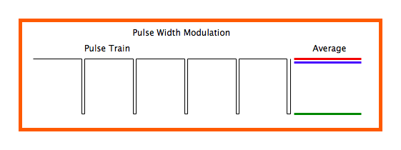
Movement
Two possible speed control methods
PWM (Pulse Width Modulation)
Voltage Control

Slide 41
Sensors
Ultrasonic Sensor
Infrared Sensor
Camera

Slide 42
Decision & Control
Image processing
Hall Effect Sensor

Slide 43
Conclusion
We hope that the X-Cali Company will be a brand new and rapidly rising brand in this market at the end of this project.

